Slide 1
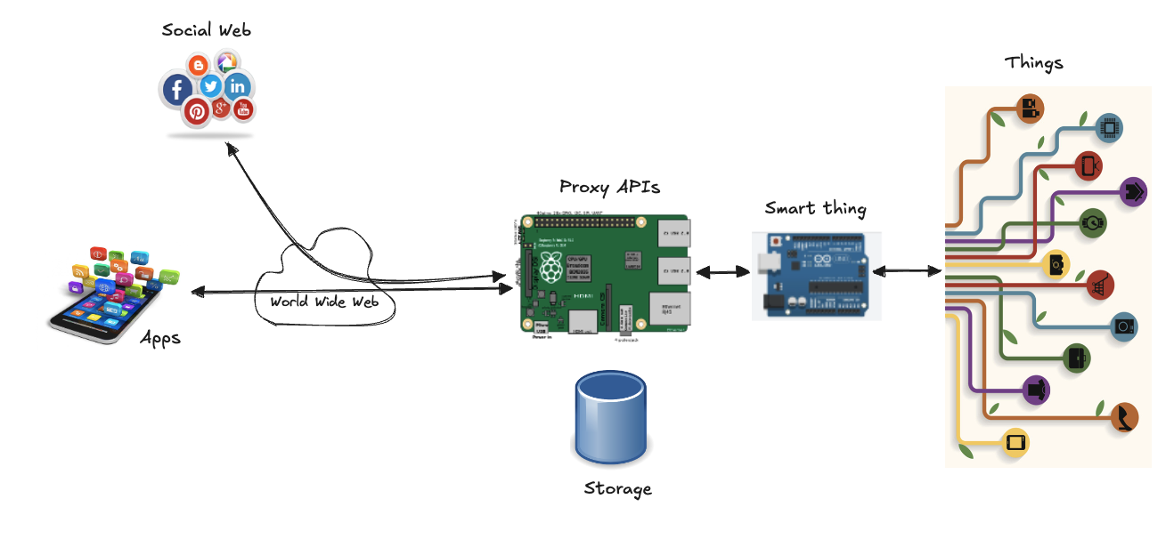
Node.js

Slide 2
What is?
A way of running JavaScript outside the web browser
created in 2009
A wrapper around the high-performance V8 JS runtime of Google Chrome
V8: newest technique in compiler technology
https://v8.dev/
performance similar to C, in a fraction of development cost
focus on performance
Additional API
Files, http, manipulation of binary data, etc.
Event-driven programming
Event loop Architecture
hides complexity of concurrency, still offering performance
non-blocking libraries
interface to filesystem or database in a event-driven way
not waiting for retrieve a file, but be notified when it has access (like onclick event)
simplified approach to access slow resources in scalable and intuitive way
It’s a server, but also a runtime environment
REPL: Read-Evaluate-Print-Loop (and interactive programming environment)

Slide 3
What is?
An easy way to build scalable network programs
LinkedIn (from Rails to Node)
servers were cut to 3 from 30
running up to 20x faster
frontend and backend teams combined
PayPal (from Java to Node)
build almost twice as fast with fewer people
double the request per second
35% decrease in average response time
Installing Node.js
https://nodejs.org/en/
Run “node” from the console for REPL
not for production code
write code with and editor in a file “name.js”, then run the file “node name.js”
meta-commands: .help .exit .clear
IDE:
IntelliJ, Editor: Atom + Atom NodeJS Packages (atom-debugger)
Visual Studio Code

Slide 4
NPM
A package manager for Node.js packages or modules
www.npmjs.com hosts thousands of free packages
What is a module?
like a library: a set of functions you want to include in your application
a set of built-in modules (core modules) you can use without any further installation
http, url, querystring, path, fs, util
many more can be downloaded...
Download a package
npm install upper-case
NPM creates a folder named "node_modules", where the package will be placed
Using a package
once the package is installed, it is ready to use (require)
let uc = require('upper-case');
You can create your own modules (local module)
exports keyword
exports.myDateTime = function () { return Date(); };
then save the code in a file called "myfirstmodule.js"
Now you can include and use the module in any of your Node.js files
let dt = require('./myfirstmodule');
notice use ./ to locate the module

Slide 5
Package.json
The manifest file of any project
contains metadata about:
identify the project: name, current version, license, author, description, etc.
functional metadata: entry point of the project, dependencies, repository links, etc.
Create a package.json
create a folder for your project
npm init
try to add a dependency (npm install upper-case)
In particular:
dependencies: third party modules installed using npm
devDependencies: dependencies that are used only during development (not used in production)
~ only update patch releases; ^ update patch and minor releases; * accept all updates, > >= any version higher (higher or equal) than the one you specify; < <= any version lower (lower or equal) to the one you specify
You can distribute your code without the “node_modules” folder
npm install (in package directory, no arguments) installs all modules listed as dependencies in package.json

Slide 6

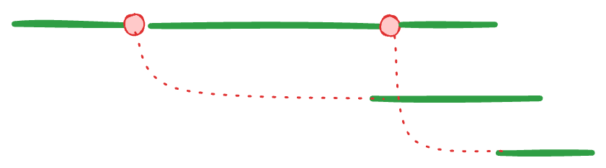
Synchronous vs Asynchronous
Synchronous, single thread
make the requests one after the other
the second will only be started when the first has finished
total time will be at least the sum of the two response times
Synchronous, multiple threads
start additional threads of control
a second thread could start the second request
then both threads wait for their results to come back
after which they re-synchronize to combine their results
Asynchronous model
starting an I/O action conceptually causes a split in the timeline
the code that initiated the I/O continues running, and the I/O is done alongside it
finally calling a callback function when it is finished

Slide 7
The file system module
“fs” module provides functions for working with files and directories
readFile:
let fs = require('fs'); fs.readFile('test.txt', 'utf8', function(error, text) { if(error) console.log('Error: ' + error); else console.log(text); });
“utf8” argument specifies the character encoding used to decode the file into a string
do not specify it to get the binary data (an array of number for each byte)
writeFile:
let fs = require('fs'); fs.writeFile('output.txt', 'Node was here', function(error) { if(error) console.log('Error: ' + error); else console.log('File written'); });

Slide 8
The HTTP Module
Node it’s a HTTP Server
unlike other languages (e.g. PHP, Java, C#) that run inside a server (e.g. Apache, IIS, etc.)
it acts as a web server by default
Code: 01.HelloWorldServer.js
Events and Callbacks
whenever there is a new request to the web server (event), it will call the anonymous method we’ve passed to deal with the request (callback)
a complete HTTP server in 6 lines of code!
a real web server usually does more:
looks at the request’s method to see what action the client is trying to perform
looks at the request’s URL to find out which resource this action is being performed on
A Client
Code: 02.HelloWorldClient.js
To make requests to HTTPS (secure HTTP) URLs, Node provides a package called https, which contains its own request function, similar to http.request

Slide 9
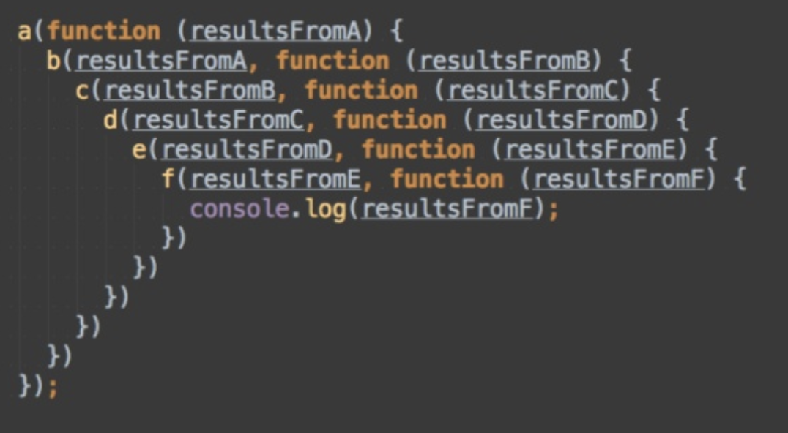
Async/Await
Before version 7.6, callbacks were the only way to run one function after another
Problem: callback hell
code can get messy when there are several functions
Function chaining function fun1(req, res){ return request.get('http://localhost:3000') .catch((err) => { console.log('found error'); }) .then((res) =>{ console.log('get request returned.'); });
Promises
functions can await the function that returns a promise
the function async needs to be declared before awaiting a function async function func(req, res){ let response = await request.get('http://localhost:3000'); if (response.err) { console.log('error'); } else { console.log('fetched response’); }
request.get() function returns a promise for which func will await
Promisify
takes a function following the common error-first callback style, i.e. taking a (err, value) => ... callback as the last argument, and returns a version that returns promises
https://nodejs.org/dist/latest-v8.x/docs/api/util.html#util_util_promisify_original

Slide 10
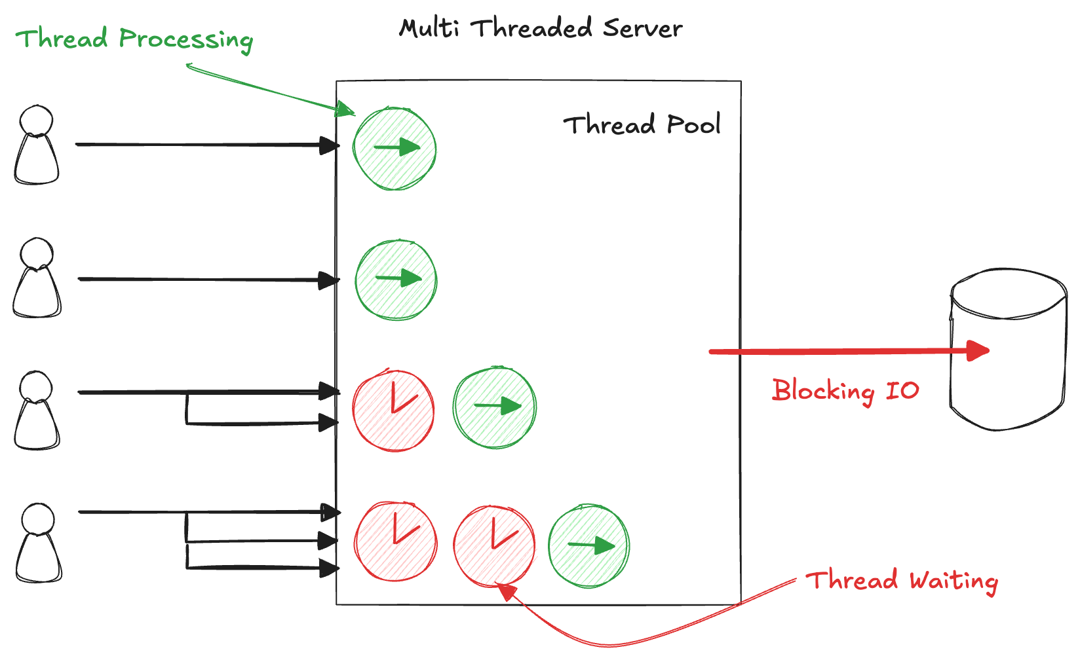
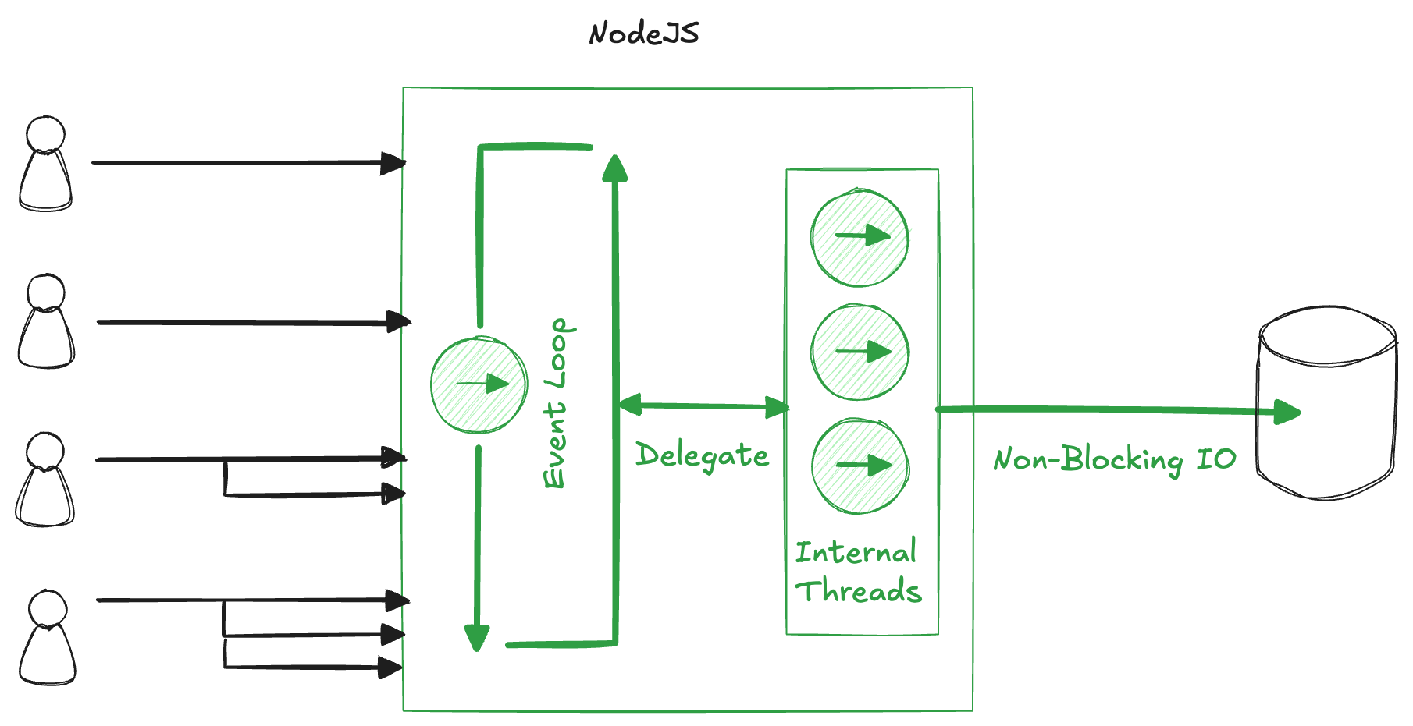
The Event Loop
Events in JavaScript are always a core part of the language
it’s designed for user interaction
on the server we have an infinite variety of events, not just the user-driver interaction
Event Loop: the JS system to deal with incoming requests
all I/O activities should be non-blocking
HTTP requests, database queries, file I/O, etc. do not halt the execution until they return data
they run independently and then emit an event when their data is available
Callbacks
JavaScript lets events drive the action, but it’s single-threaded

Slide 11
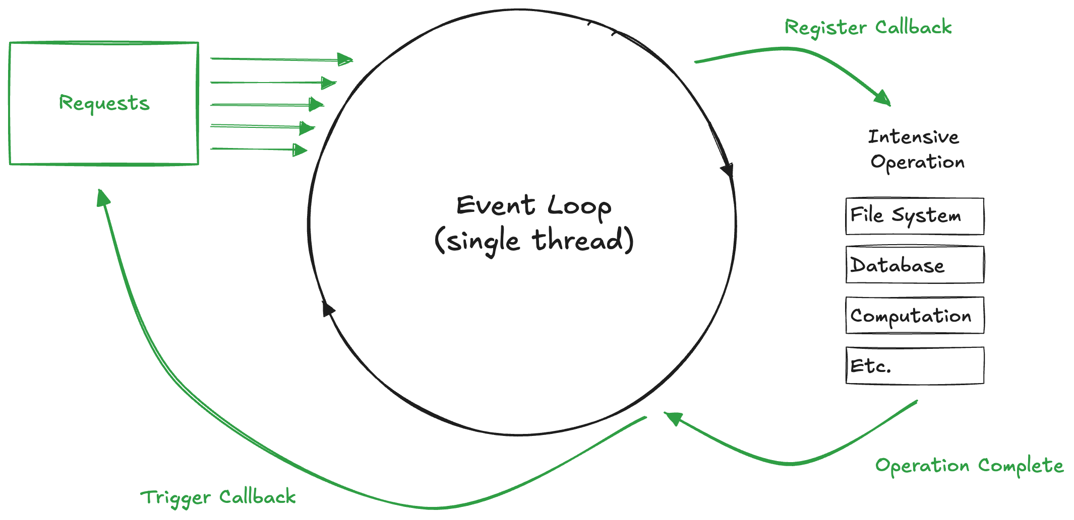
The Event Loop
The message queue is a list of messages to be processed
while(queue.waitForMessage()){ queue.processNextMessage(); }

Slide 12
Streams
Collections of data (like arrays or strings)
might not be available all at once, and they don’t have to fit in memory
really powerful when working with large amounts of data
or data that’s coming from an external source one chunk at a time
We have seen two examples of writable streams in the HTTP examples
the response object that the server could write to
the request object that was returned from http.request
Four fundamental stream types
Readable
Writable
Duplex
Transform streams
All streams emits events that can be used to read and write data
readable.on('data', (chunk) => { writable.write(chunk); });
readable.on('end', () => { writable.end(); });
The simpler way to consume streams data is the pipe method
readableSrc.pipe(writableDest)
we’re piping the output of a readable stream as the input of a writable stream

Slide 13
Serving a big file
An example demonstrating the difference streams can make in code when it comes to memory consumption (code: 03.Streams)
Create a big file first
run create.js, it generates big.file ~400 MB
Setup a simple server to exclusively serve the big.file (server_1.js)
when gets a request, it serves big file using the asynchronous method, fs.readFile
monitor the memory
when you ran the server, it started with a normal amount of memory, like 8.7 MB
when you sent a request, the memory consumption jumped to 434.8 MB (the whole big.file content is in memory before sending it out to the response object)
this is very inefficient
HTTP response object is also a writable stream!
we can pipe the two on each other in order to not consuming ~400 MB of memory
see server_2.js, in particular createReadStream function
now the memory consumption grew by about 25 MB and that’s it
Try server_1.js and server_2.js with a 2GB file (create.js with 5 millions of lines)
what’s happens?

Slide 14
A simple file server
Combine knowledge about HTTP servers and talking to the file system, to create a bridge between them
an HTTP server that allows remote access to a file system
useful for web applications to store and share data, or for a group of people to share a bunch of files
Assumptions:
when we treat files as HTTP resources, the HTTP methods GET, POST and DELETE can be used to read, write, and delete the files
we will interpret the path in the request as the path of the file
we don’t want to share our whole file system, so we’ll interpret these paths as starting in the server’s working directory
Code: 04.FileServer.js
try with Postman

Slide 15
A Chat Server
Code: 05.ChatServer.js
to use it: “telnet localhost 9000”, or on Mac use “nc” (netcat)
Use of the “net” library, which contains all TCP stuff
Two event listeners:
one for the “connection” event: when a new client arrives
one to manage data coming from each client (“on” event)
in the scope of the previous
Possibility to decorate objects with additional properties
Fatal flaw!
if a client disconnect, it fails horribly!
code: 06.RobustChatServer.js
we have to remove a client from the list when it disconnect, so we stop making write method call on it (and V8 garbage collector can reclaim that memory)
we have to be more defensive when we write to a socket by checking if the socket is writable or not
we add a method to log errors that can occur to clients

Slide 16
Express (1)
A web application framework
allows to set up middleware to respond to HTTP requests
defines a routing table to perform different actions based on HTTP Method and URL
npm install express --save (--save, install the module globally)
Hello world example
const express = require('express'); const app = express(); app.get('/', function (req, res) { res.send('Hello World'); }) const server = app.listen(8081, function () { const host = server.address().address const port = server.address().port console.log("Example app listening at http://%s:%s", host, port) })
Express uses callback functions with request and response objects
request has properties for the query string, parameters, body, headers, and so on
response object represents the HTTP response
Basic routing
use methods of the Express app object that correspond to HTTP methods
app.get(), app.post, ...

Slide 17
Express (2)
Middleware
small piece of code that sits in between the request event and the route (.post())
to reuse code for common tasks (authentication, logging, streaming data)
make code more clear
example: body-parser (npm install body-parser)
Let’s build Twitter!
write a simple web application (like Twitter) using Express
Code: 07.Twitter.js
open browser to: http://localhost:8000/tweets
use Postman to send tweets
POST http://localhost:8000/send body: tweet=ciao come stai?
Test-Driver Development (TDD)!
useful to write test to make sure our code is working correctly
write test BEFORE code
Assert: a core module to test returned values in several way and throwing exceptions
Code: 08.TwitterTest.js
we will see more advanced tools to develop unit-testing

Slide 18
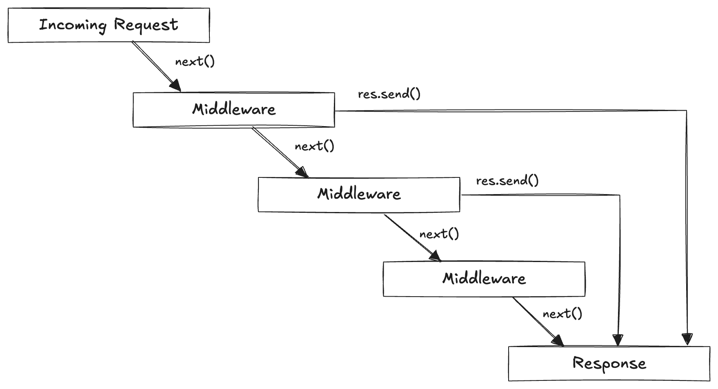
Express (3)

Slide 19
Why Node.js and IoT?
Scalability
when everything begins to acquire intelligence and require data management, network control and design will need to change
Google V8 engine
speed, scalability, efficiency
great to develop data-intensive, real-time applications
Effective communication
APIs fit well the IoT model
it’s extremely efficient build REST API with Node.js (e.g. Linkedin builds its mobile API)
many frameworks: Hapi, Restify, Express
devices (sensors, beacons, wearables, etc.) generate large floods of requests
Node is well suited for managing these requests via streams that can be processed and monitored very efficiently
no caching, no temporary-data - just stream from one place to another
Resources
Node.js has very low resource requirements

Slide 20
Hands-on Activity
Improve the file server to create folders. Add support for a method PUT, which should create a directory by calling fs.mkdir
Improve the Twitter application to provide a support for hashtags. The term in the URL path of a GET is the hashtag, the server must provide just the posts containing that word

